Slide 1
Freshmen Orientation
Saturday, July 29, 2023
Northeast High School

Slide 2
Mr. Michael Hernandez Principal
Welcome to Northeast

Slide 3
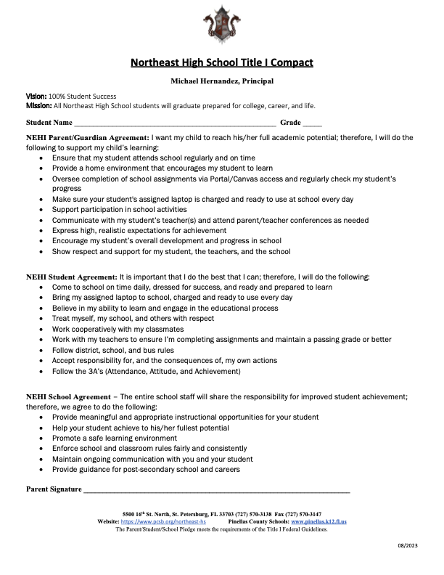
Title 1
Annual Meeting

Slide 4
Mr. Marc Allison
AP for Athletics
Class of 2027 Administrator
Freshmen Transition

Slide 5
Mr. Eric Malm
Class of 2027 Counselor
Focus on Graduating
& Beyond

Slide 6
Minimum 24 credits
Passing Scores on Florida State Tests
Grade 10 FAST ELA/Reading
Algebra 1 EOC
Minimum of 2.0 GPA
Graduation Requirements

Slide 7
English – 4 Credits
Math – 4 Credits (1 Algebra 1 & 1 Geometry)
Science – 3 Credits (1 Biology)
Social Studies – 3.5 Credits (World History, US History, .5 Government, .5 Economics, .5 Financial Literary)
Required Credits

Slide 8
H.O.P.E. – 1 Credit
WAIVER INFORMATION: Student who has played 2 seasons of JV/Varsity sports for Northeast High School and/or JROTC students with 2 credits in Leadership are eligible to complete a HOPE Waiver
Art – 1 Credit
Elective – 8 Credits
1 Online Course
Required Credits

Slide 9
Minimum 2.0 GPA (C Average)
Students who fail a required Core class will be required to retake the class to recover the credit lost
Students whose GPA falls below a 2.0 will be required to take Credit Recovery classes to increase their GPA
Some Credit Recovery classes can be taken during the school day; others may have to be taken after school or during Summer School
GPA Requirements

Slide 10
Use the Self-Credit Check to keep track of requirements.
What can Students Do?

Slide 11
Obtain a Parent Focus Portal Username and Password
Keep track of your student’s Assignments, Grades, Test History, and Attendance
If you need help, please contact Ms. Milne milnek@pcsb.org, Ms. Sipe sipesd@pcsb.org, or Ms. Johnson johnsonshani@pcsb.org.
What can Parents Do?

Slide 12
Mrs. Stacey Mullaney
AP for Curriculum
Honors College & Enrollment

Slide 13
Mrs. Libby Taylor
AVID Coordinator
AVID

Slide 14
AVID Requirements for Freshmen:
take at least 1 honors level class
maintain a minimum GPA of 2.5
participation in AVID Tutorials
good attendance
Freshmen AVID

Slide 15
Coach White
Athletic Coordinator
Student Activities
& Athletics

Slide 16
Fall | Winter | Spring
Bowling Cross Country Football Football Cheer Golf Swimming Volleyball | Basketball Basketball Cheer Soccer Wrestling | Baseball Flag Football Lacrosse Softball Tennis Track
Athletics Calendar

Slide 17
Physical Benefits (reduced health risks heart disease, stroke cancer and diabetes)
Enhance child’s self-perception of body, competence and self-worth
Athletes typically have higher GPAs
More likely to attend college
Earn higher incomes
Up to 40% higher test scores
Benefits of Sports

Slide 18
FHSAA Academic State Champions in
Baseball - 2019 -2020
Boys Bowling - 2022-2023
Girls Golf – 2022-2023
Points of Pride

Slide 19
Maintain at least a 2.0 GPA
Complete an Athletic Packet
Complete three online courses:
Sudden cardiac arrest
Concussion for students
Heat illness preventions
Purchase Student Accident Insurance
Requirements to Play

Slide 20
5000 Role Model Len Chatman
Academic Team David Ashe
Art Club Kevin Olis
Chess Club George Avlonitis
Chorus Scott Bracken-Tripp
Culinary Club Curtis Serata
Digital Media Club William White
Fellowship of Christian Athletes George Avlonitis
Forensics (Debate) Bernadette Langiotti
French Club Michel Honein
Friends, Inc Scott Peterson
Freshman Class Amy Boylen
Future Business Leaders of America Travis Bailey
Gaming Club David Ashe, Bernadette Langiotti
Girlfriends Sharon Joe
GSA Kristen Engle
Health Club Reshaun Reno
JROTC Color Guard, Drill Team, Raiders Kevin Miller, Joseph Walker
Key Club Ruth Pica
Live Free/Save Clubs Kristen Engle, Scott Bracken-Trip
Mu Alpha Theta James Zack
National Honors Society Kristen Bercume
National English Honors Society Joseph Havelka
Nor’easter (Newspaper) Bernadette Langiotti
Principal’s Multicultural Advisory Council Adrian Perazzo
Psychology Club Brandon Diaz
Scarlett Regiment Band Devon Porter
Student Government Association Ruth Pica
Skills USA Curtis Serata
Sounds Literary Magazine Bernadette Langiotti
Spanish Club Adrian Perazzo
Spanish Honors Society Adrian Perazzo
Thespian Troupe Kristen Engle
Yearbook (Viking Log) Bernadette Langiotti
YGG Crew Joseph Havelka
Student Clubs

Slide 21
Lieutenant Colonel Miller
JROTC Director
JROTC

Slide 22
Ms. Lisa McNew
School Nurse
Clinic & Health Services

Slide 23
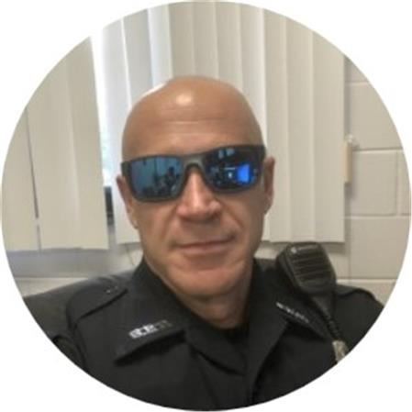
Officer Stone
Officer Settle
School Resource Officers (SRO)
Campus Safety

Slide 24
Mr. Kem Mosley
Academy of Finance Teacher
Achieva Branch

Slide 25
Mr. Aaron McWilliams
Class of 2025 Administrator
Parent Teacher
Organization

Slide 26
Parent Teacher Organization(PTO)
Volunteerism
School Advisory Council (SAC)
Boosters
Stay Connected

Slide 27
Mrs. Stacey Mullaney
AP for Curriculum
Focus Overview

Slide 28
Mr. Tom Reckenwald
Academy of Finance Teacher
Transportation

Slide 29
See Mr. Reckenwald if:
If you have requested a bus but do not plan to use it.
If you need a bus but have not been assigned one.
If you do not know your stop.
Transportation

Slide 30
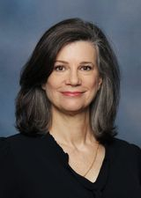
College & Career Center
Resource for NEHI Students open during the school day
Located in Guidance 1-133
Collaborates with counselors and staff to support student’s pathway progression and plans for college, career, or military
Naviance is an important tool to help your student
Volunteers & Business Partnerships
New volunteers must register and have a background screening
Returning volunteers must re-activate each year
All volunteers must sign-in and need to log hours.
Learn more and register/re-activate at www.pcsb.org/Page/459
Ms. Sarah Alvarez
College & Career Coordinator
alvarezsa@pcsb.org
College & Career

Slide 31
Administration &
Counseling Team
Question & Answer

Slide 32
Please join us on
August 22 at 6pm
for our annual
Back to School Night
Back to School Night

Slide 33
Picture Day for all 9 – 11 grade students will be August 31.
All students must be photographed for their ID.
Picture purchasing packets will go home shortly.
Picture Day

Slide 34
Distribution Windows
Saturday, 7/29: 8:00a.m. – 12:00pm
Wednesday, 8/2: 9:00 a.m. – 12:00 p.m.
Thursday, 8/3: 12:00 p.m. – 2:00 p.m.
Tuesday, 8/8: 10:00 a.m. – 12:00 p.m.
Wednesday, 8/9: 11:00 a.m. – 2:00 p.m.
Laptop Checkout

